Slide 1
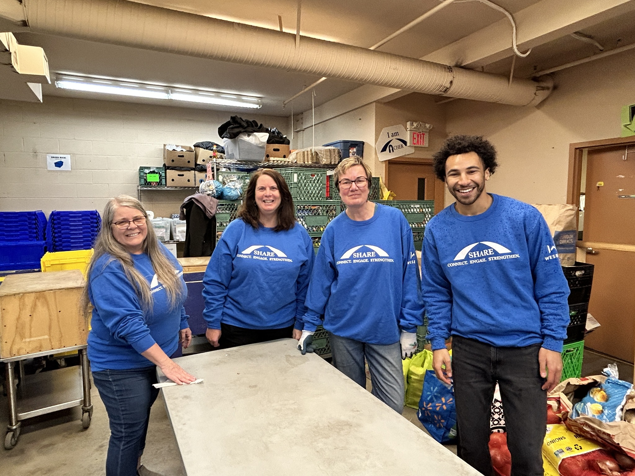

Help your community
Tap and Give

Slide 2
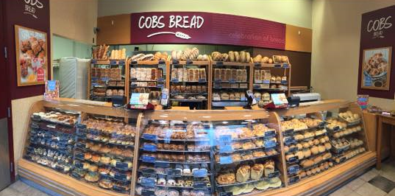
This fundraising initiative
is sponsored by
COBS Suter Brook!

Slide 3

tapandgive.net

